Slide 1
Ising Model in Python
Joey Latta
Python-Based Physics Problems

Slide 2
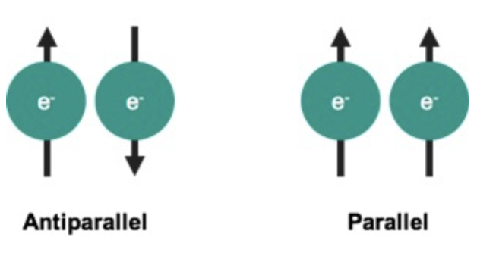
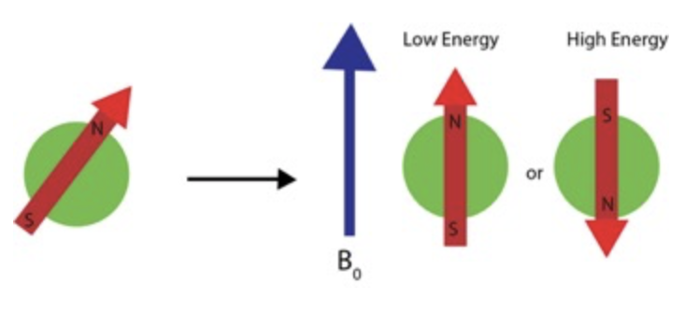
Background
Ising Model: mathematical model of ferromagnetism in materials
Ferromagnetism occurs based on two sources:
Electron magnetic moments and Exchange interactions
Purely quantum mechanical interactions
The exchange interaction creates an energy difference between spin up and spin down states
Nearby spins tend to align in same direction (reducing electrostatic repulsion)
Spins tend to align with external magnetic field

Slide 3
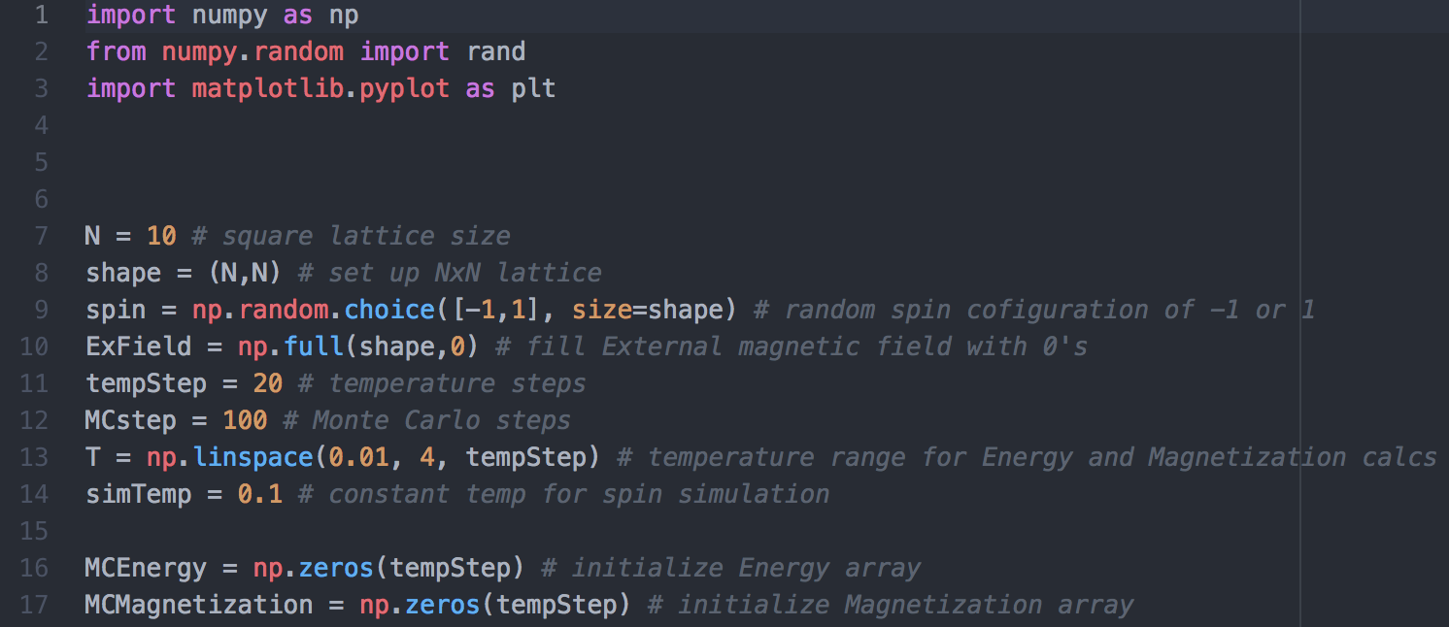
Model
Ferromagnetics exhibit long-range ordering on an atomic level resulting in formation of domains - unpaired electrons with identical spins
Dipoles tend to align spontaneously, even in absence of external magnetic field
Model as square lattice: each cell represents an electron spin with 1 or -1
Spins at edges are considered neighbors (torus-like)
No external field: 𝐸𝑖𝑗 = −𝐽𝜎𝑖𝜎𝑗, J = coupling constant, 𝜎𝑖𝜎𝑗, are spins
Total energy of spin: 𝐸k =−𝐽𝜎k ∑︁𝜎i
Model undergoes phase transition at: 𝑇𝑐 = 2J / 𝑘ln(√2+1)

Slide 4
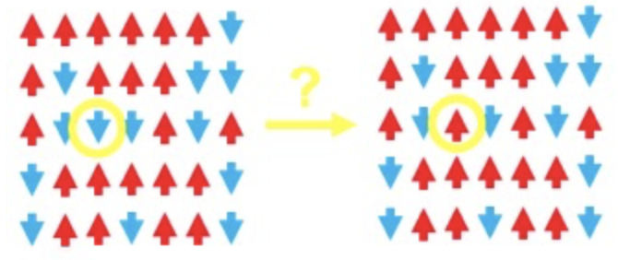
Metropolis Algorithm
At each step, randomly pick a site:
Calculate overall change in energy if the spin is flipped
If new energy is lower -> accept the flip
If new energy is, flip based on probability P = H(𝜎) - H(𝜎’) / kT
Lower energies configurations are always preferred
Higher energy configurations increase in probability as T increases

Slide 5
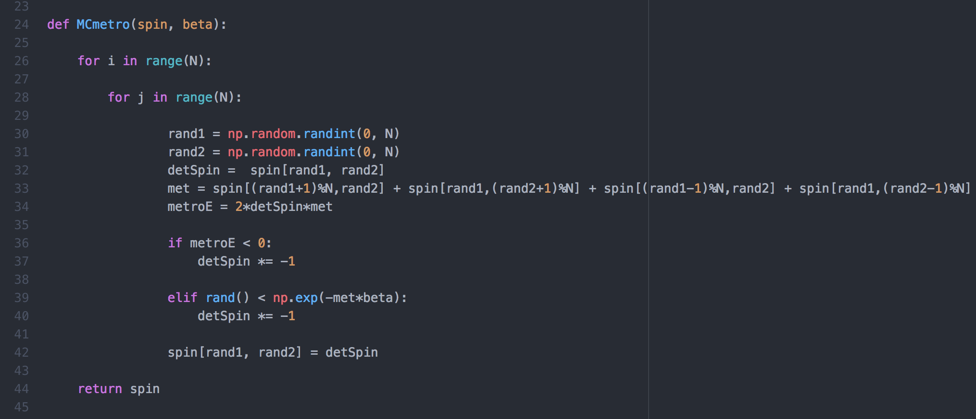
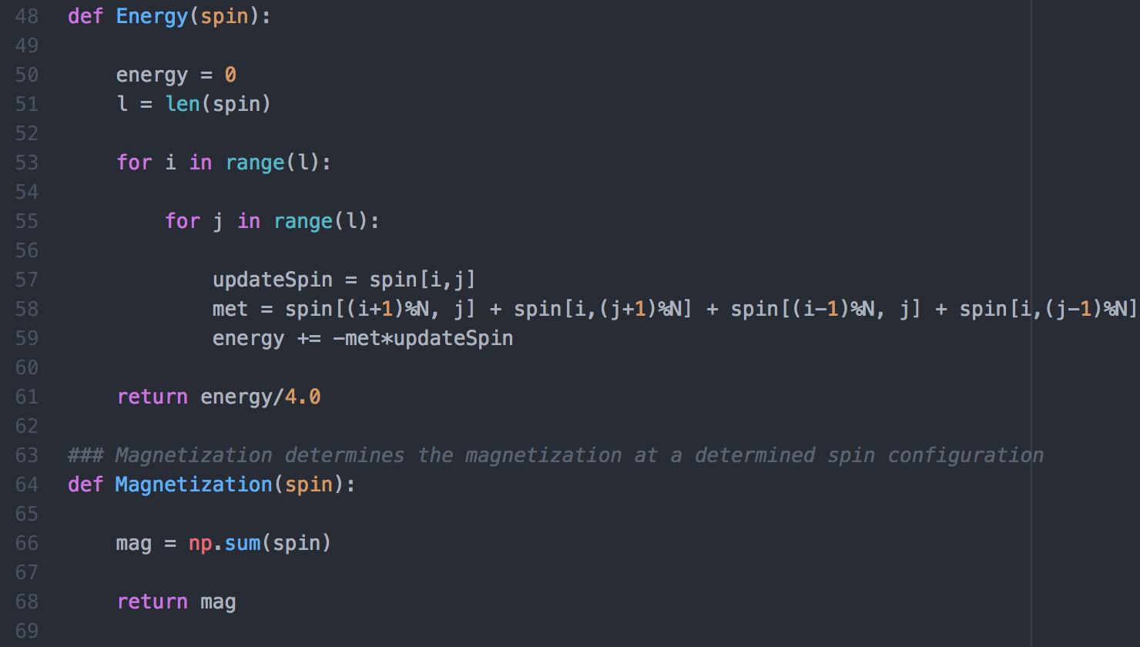

Slide 6
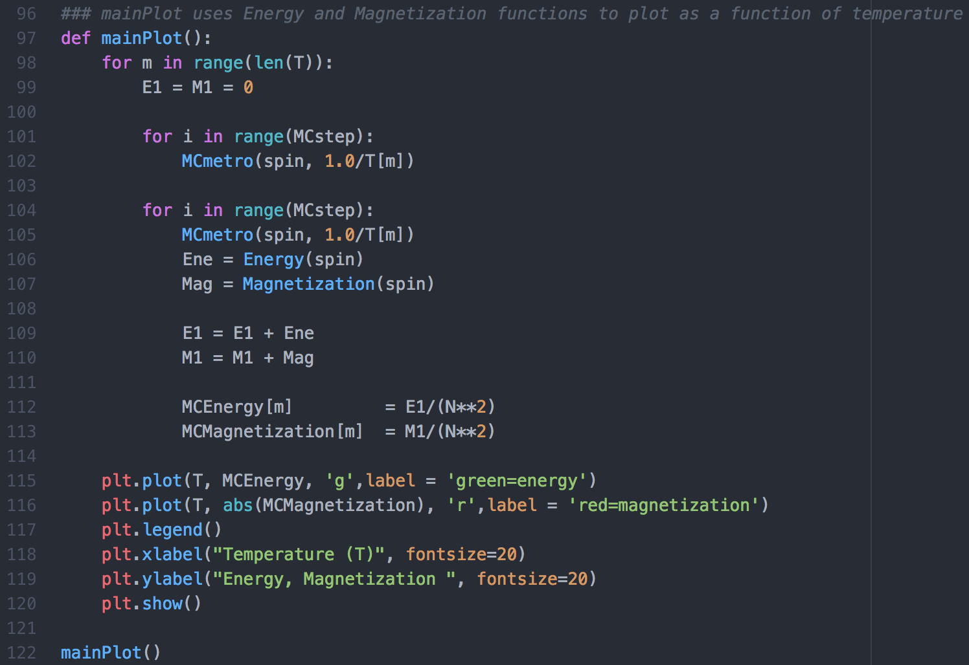
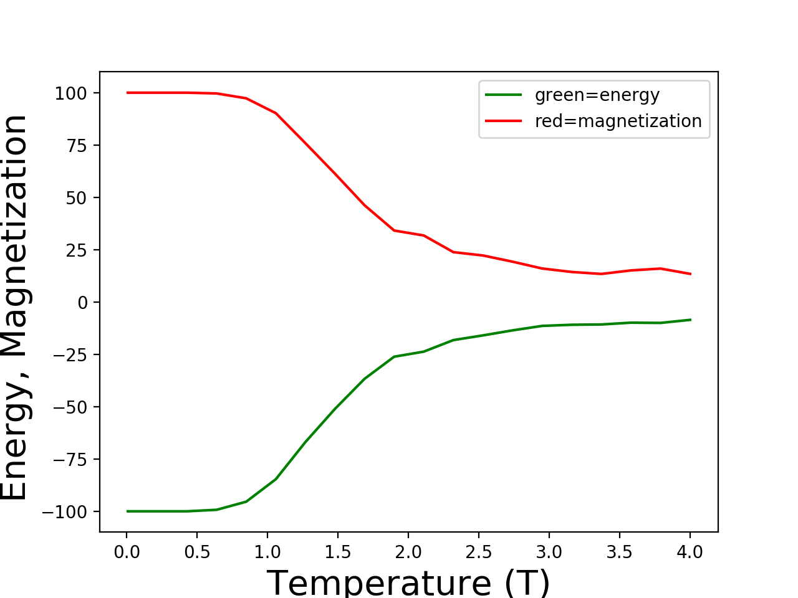
Plot
100 MC Steps
(~1 sec)

Slide 7
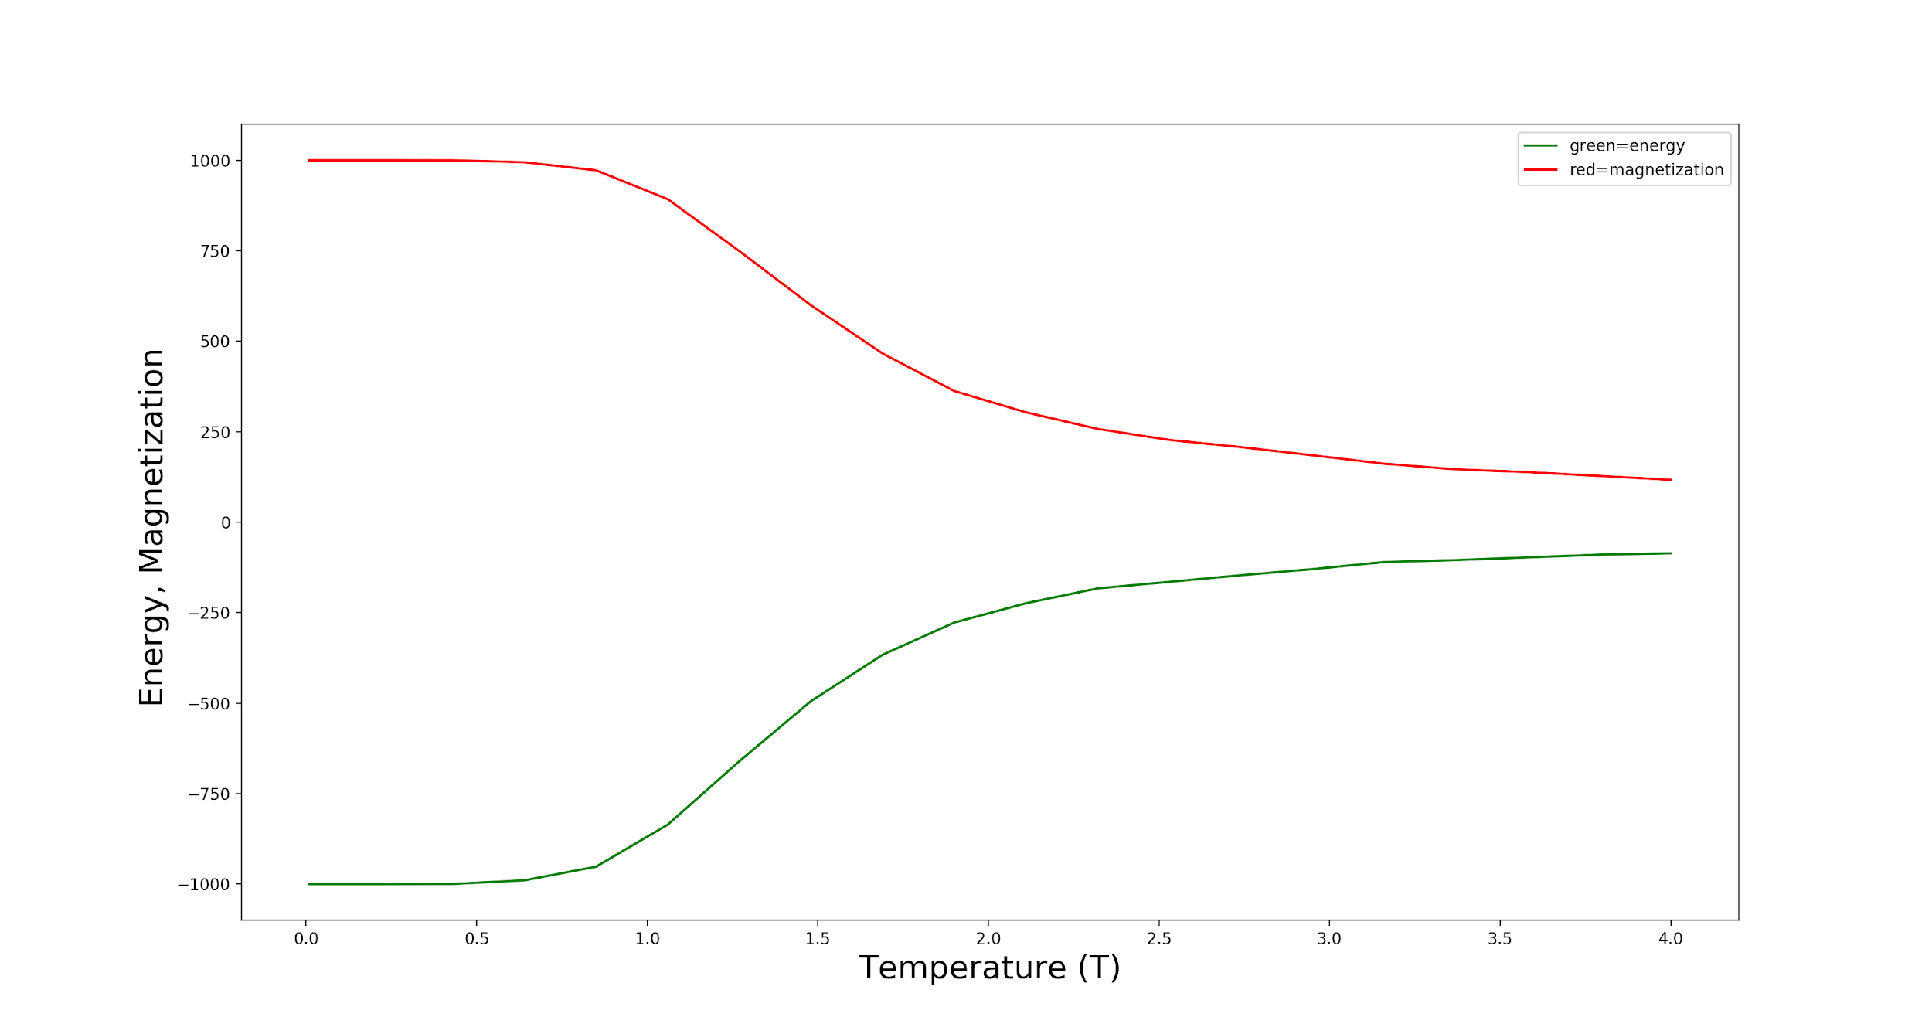
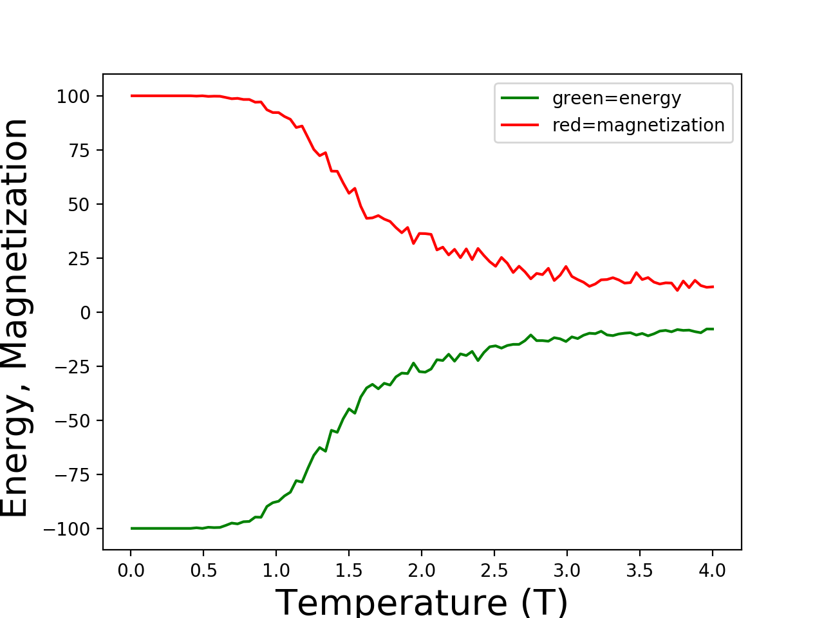
100 Temp Steps
~10 sec
1000 MC Steps
~2 mins

Slide 8
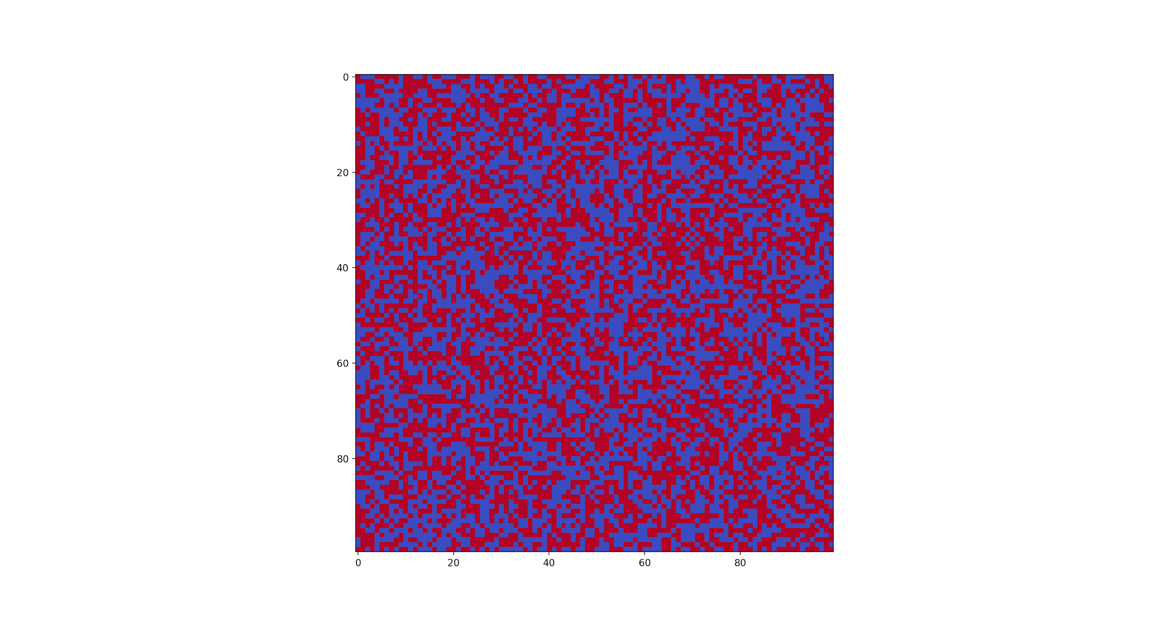
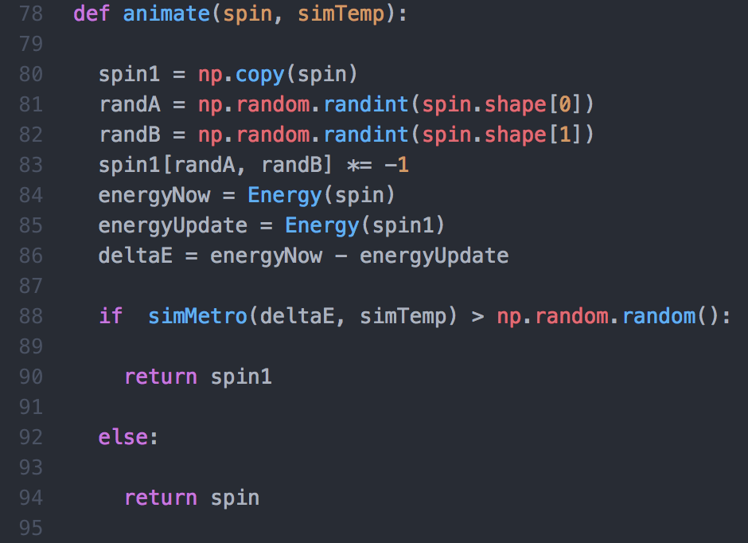
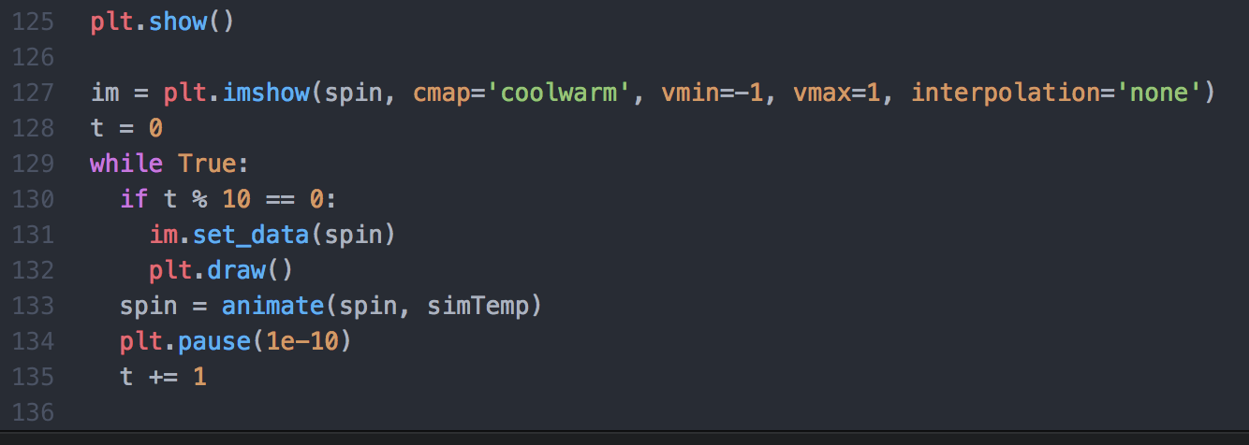
Animate

